Slide 1
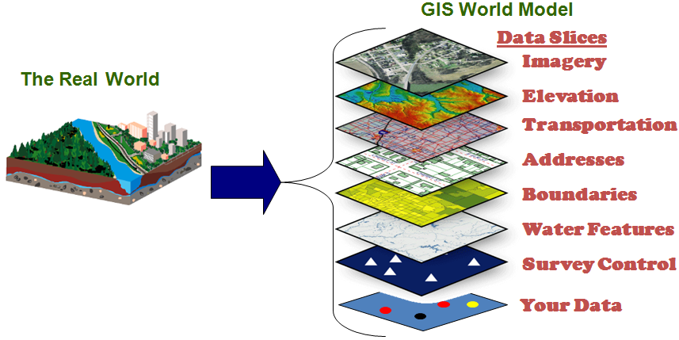
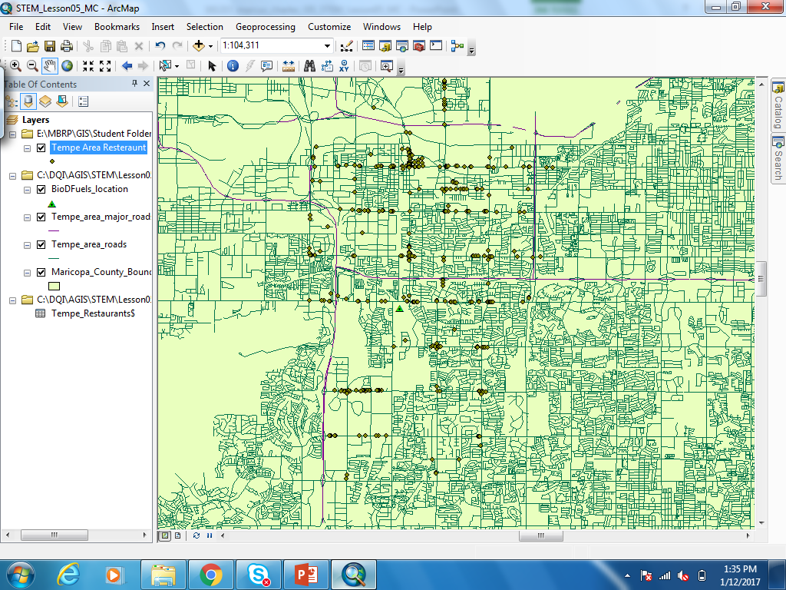
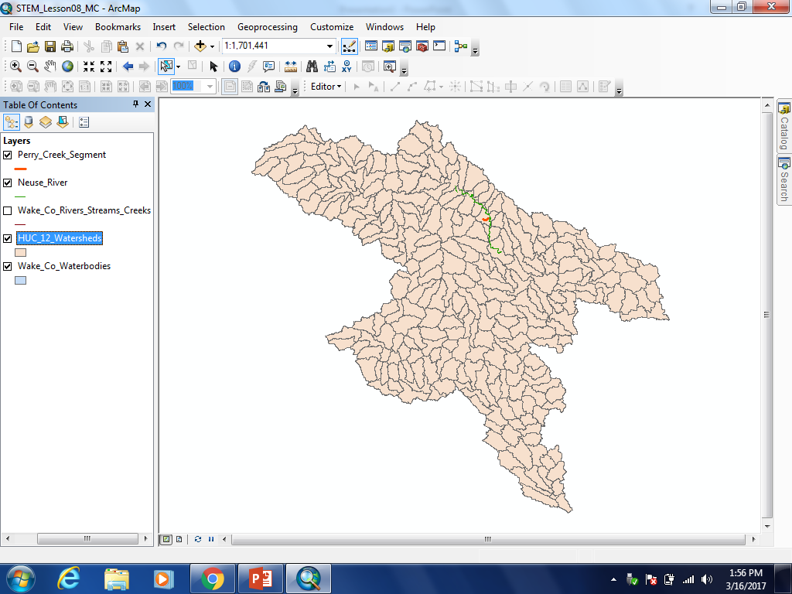
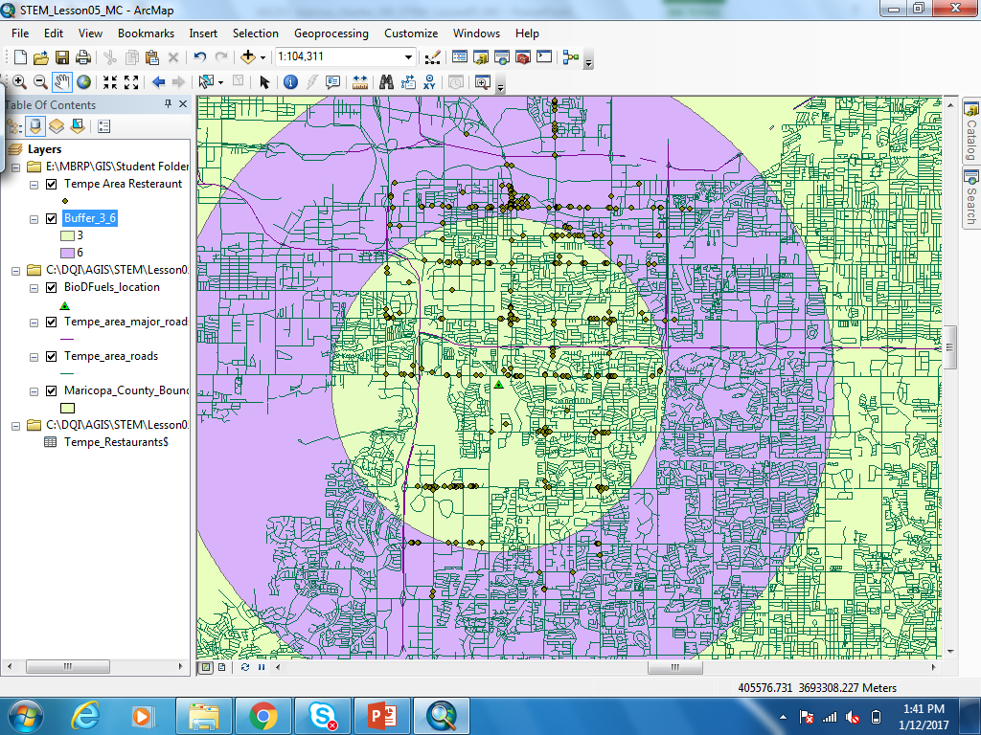
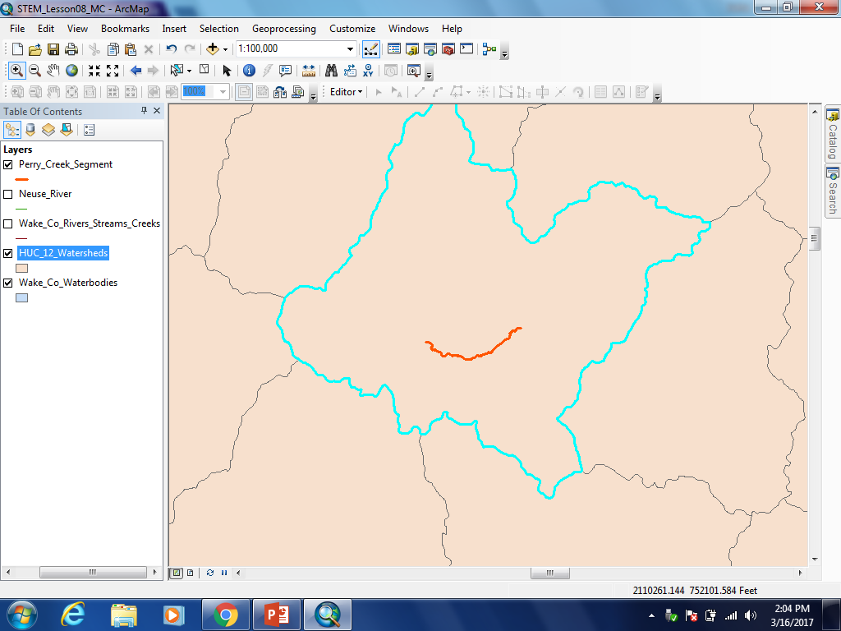
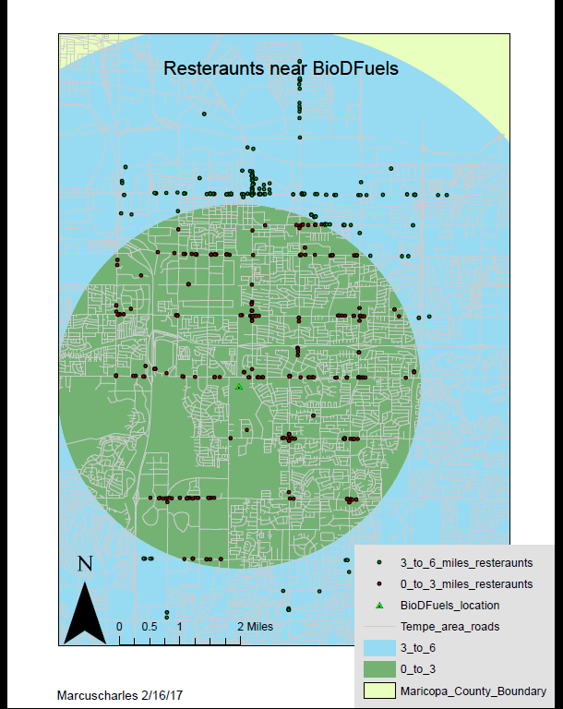
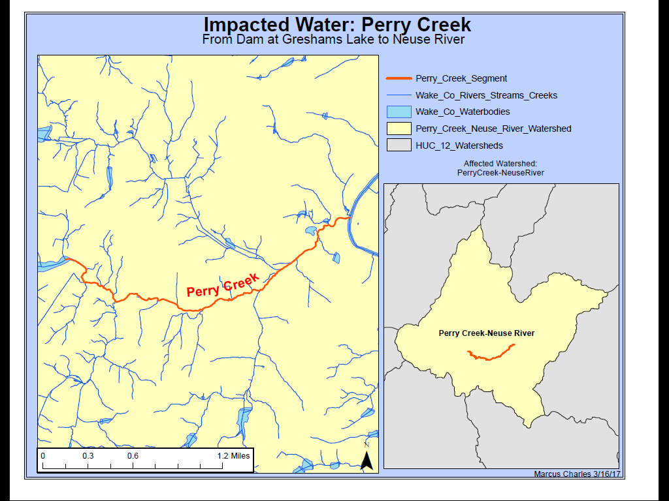
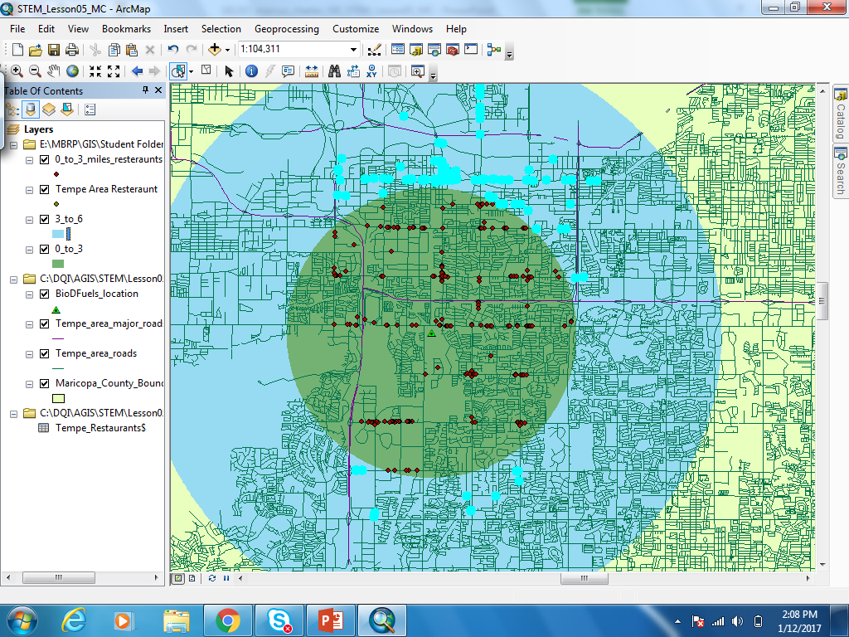
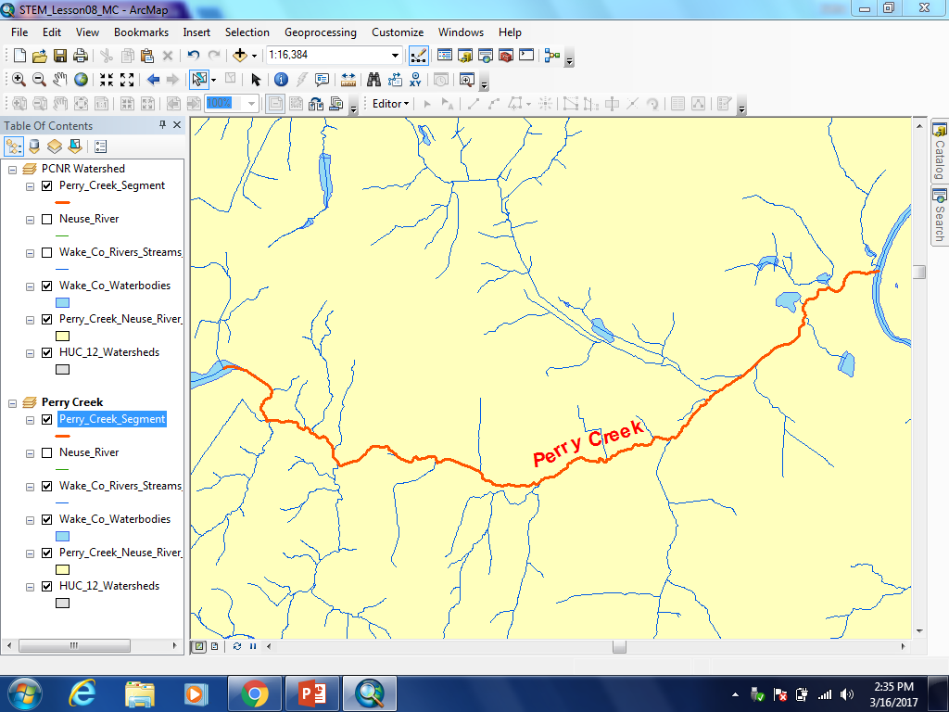
Geographic Information Systems for Sustainability
`
Map #1: Where can a biodiesel fuel company “strike” oil
Introduction and Background:
Map #2: Which watershed should receive funding?
Geographic Information Systems (GIS) are used by many companies all over the world, as well as regular people in day to day life. It can be used in multiple forms such as digital maps, remote sensing, Global Positioning Systems, and many others. Just getting onto Governors Island or going back home would take someone who doesn’t know where they’re going at least four maps to find their way: For coming to the ferry building, for the person driving the boat, for walking to the school, and for inside the building. One of two maps presented today are for a biodiesel fuel company who wants to locate the restaurants around their base and determine the best route to collect fuel (map 1). The other map is for finding impaired streams and waterways in a set of watersheds, the water routes are all connected in a watershed so if one is influenced eventually so will all of the other waterways. If one watershed were to become heavily impaired it would have an even bigger affect on all the other water sheds around it. Healthy watersheds provide water for every applications such as taking a shower or brushing your teeth so it’s important that they’re properly monitored (map 2).
Fig 03: First the location of the biodiesel company had to be determined and plotted followed by the surrounding restaurants. The streets were drawn so that routes to each restaurant could be plotted .
Fig 06: The highlighted section on the map is the most damaged watershed, this can be found out by using the properties table function which gives a list of the selected area’s physical properties
Map #1
Map #2
Fig 04: After the key locations had been plotted the area around the company’s base was highlighted. A ring buffer from 0 to 3 miles and another from 3 to 6 miles were created and then made into a single item using the clip function.
Fig 07: After determining which waterway was damaged using the properties table function we highlighted the waterbody, which is known as Perry Creek. The streams and rivers layer around it were turned off to give an unimpeded view of the problem, the watershed was then colored in.
Fig 05: The area inside the outer ring was highlighted and given a color, then to make sure all the points on the map would pop out we clipped the points to the buffer so that they were “on top” of the map.
Fig 08: After selecting Perry Creek we used the zoom to feature function to take a closer look, we added in all the waterways around it to get an idea of the areas it may be affecting as well as for reference points. A legend was added that can be used for both maps.
Fig 01: Map of BioDfuels and locations around them in a 6 mile radius
Fig 02: Map of damaged waterbody for companies looking to invest money in local watersheds

