Slide 1
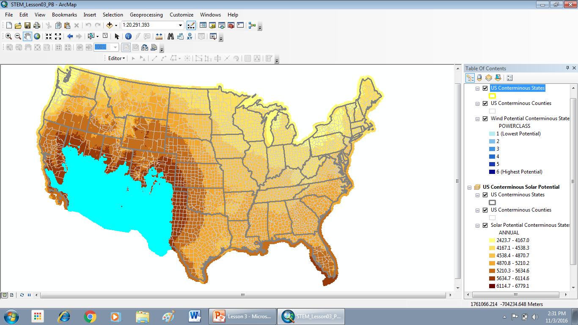
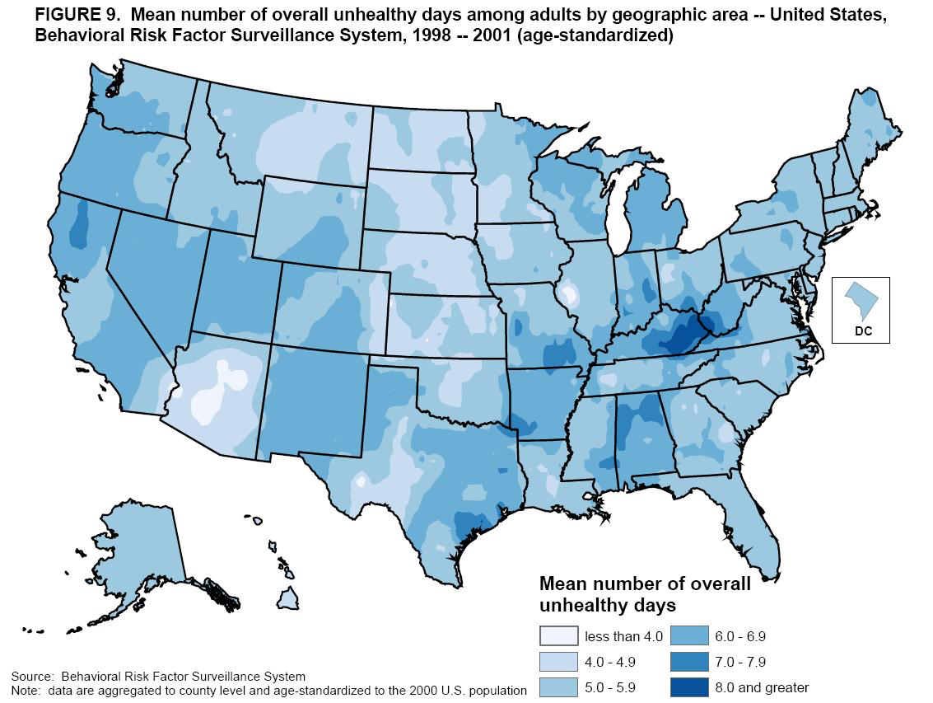
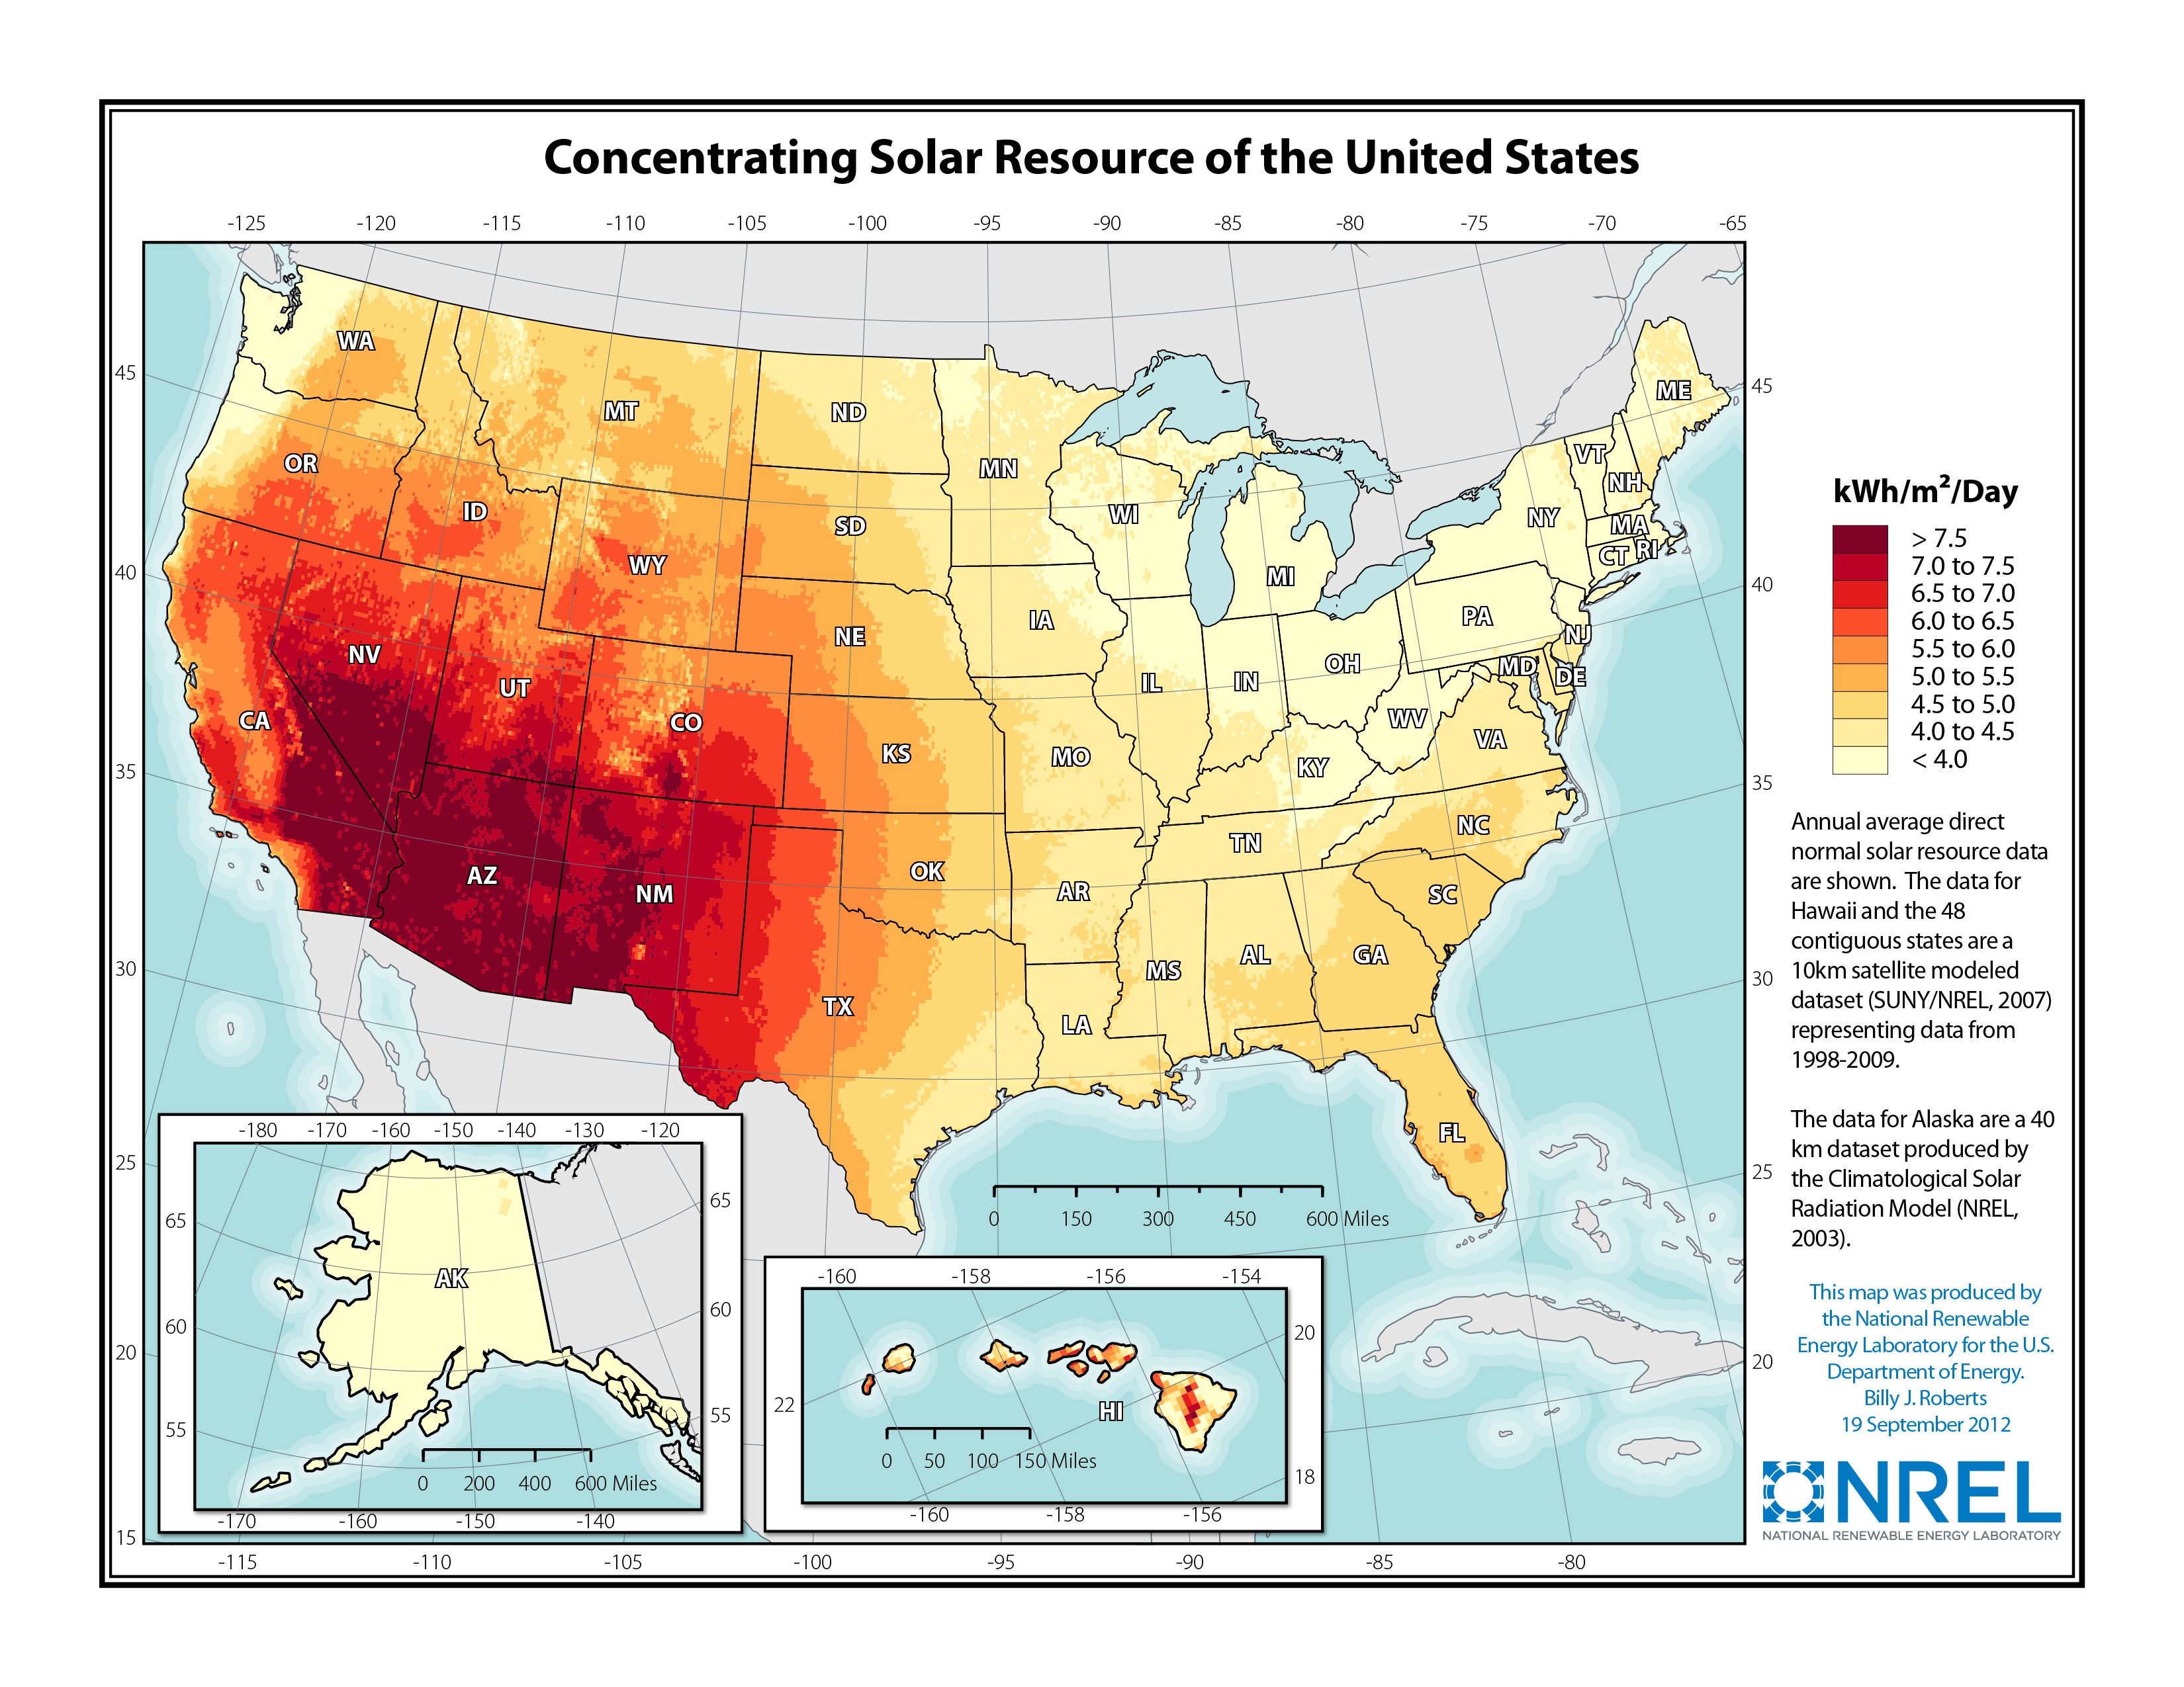
`
Geographic Information Systems and Its Use Within the Real World
Introduction
Solar Potential Map of U.S
Methods
This project was produced to show the various uses of GIS outside it’s Governmental and Cartographic uses. GIS (Geographic Information System) is a computer system that is used to capture, store, check, and display data related to positions throughout the Earth. It has been in use by many research organizations, private companies, and even Federal bureaus. Due to its flexible programming GIS can be implemented in just about any situation, provided with the correct information and what the person(s) intentions are for its use.
Data is first displayed on Excel spreadsheet
Depending on project, implementation of buffer in toolbox
Colors and symbols to represent important areas or patterns (edited in table of contents in ArcMap)
Map is based on black template, user forms the way map or its features appear.
Analysis
Many organizations have a primary responsibility of maintaining authoritative records about the status and change of geography (geographic accounting). Cultural geography examples are zoning, population census, land ownership, and administrative boundaries. Physical geography examples include forest inventories, biological inventories, environmental measurements, water flows, and a whole host of geographic accountings. GIS provides a strong framework for managing these types of systems with full transaction support and reporting tools. These systems are conceptually similar to other information systems in that they deal with data management and transactions, as well as standardized reporting (e.g. maps) of changing information. However, they are fundamentally different because of the unique data models and hundreds of specialized tools used in supporting GIS applications and workflows. - (9/14/09 Matt Artz) - https:/gisandscience.com/2009/09/14/top-five-benefits-of-gis/
Objective/Problem
Why isn’t GIS used in a consumer society?
Why do people insist on using pre-programmed maps?
What can GIS be use for in a consumer society?
Figure 01. Map of U.S with areas of high solar potential (blue) based on data input.
Background Information
With GIS technology, people can compare the locations of different things in order to discover how they relate to each other. For example, using GIS, the same map could include sites that produce pollution, such as gas stations, and sites that are sensitive to pollution, such as wetlands. Such a map would help people determine which wetlands are most at risk. GIS can use any information that includes location. The location can be expressed in many different ways, such as latitude and longitude, address, or ZIP code. Many different types of information can be compared and contrasted using GIS. The system can include data about people, such as population, income, or education level. It can include information about the land, such as the location of streams, different kinds of vegetation, and different kinds of soil. It can include information about the sites of factories, farms, and schools, or storm drains, roads, and electric power lines. With all these set of information maps can be made based on them to various things such as patterns and trends.
(https://www.nationalgeographic.org/encyclopedia/geographic-information-system-gis/)
Conclusion
G.I.S benefits organizations of all sizes and in almost every industry. There is a growing interest in and awareness of the economic and strategic value of G.I.S, in part because of more standards-based technology and greater awareness of the benefits demonstrated by G.I.S users. The number of G.I.S enterprise solutions and IT strategies that include G.I.S are growing rapidly – (9/14/09 Matt Artz)https:gisandscience.com/2009/09/14/top-five-benefits-of-gis/
Figure 02. Overall unhealthy days among adults.
Figure 03. Concentrated solar resources in the U.S

