Slide 1
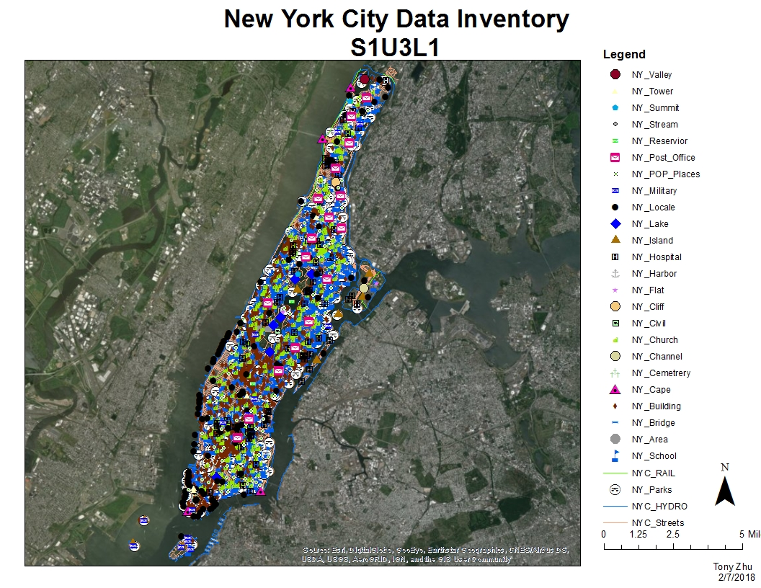
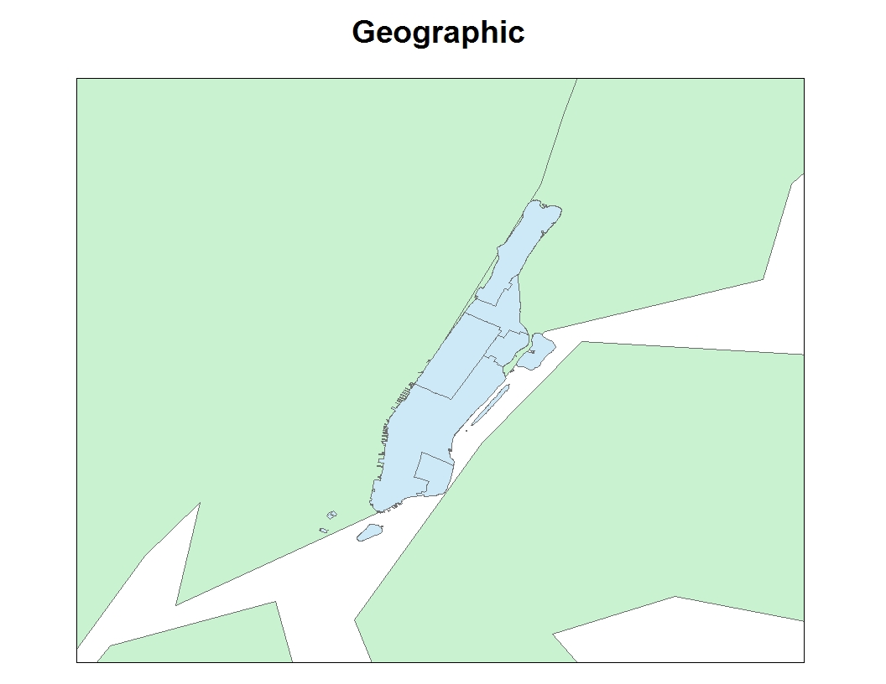
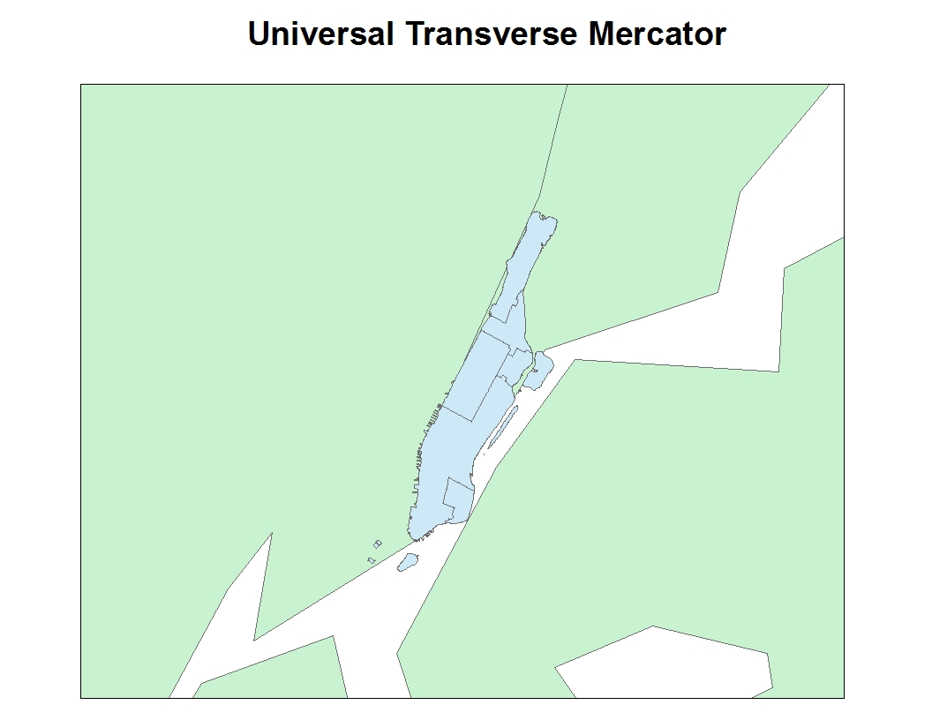
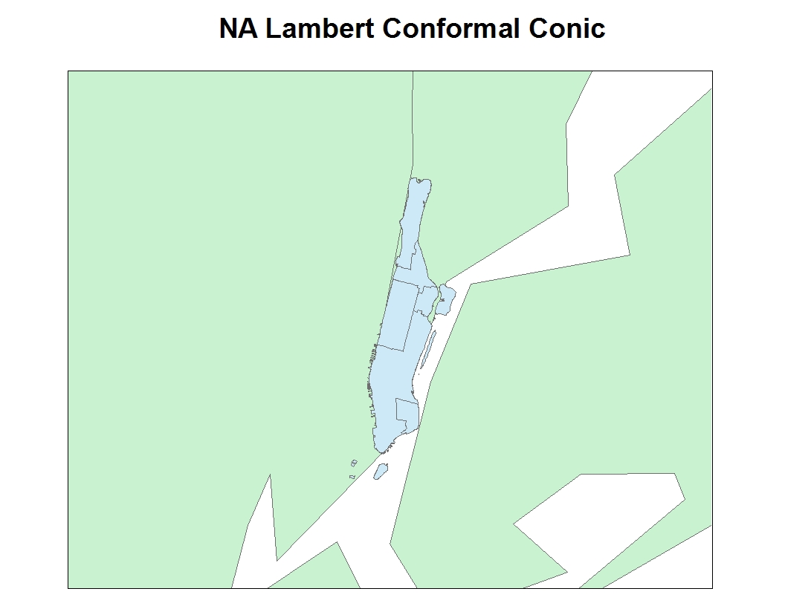
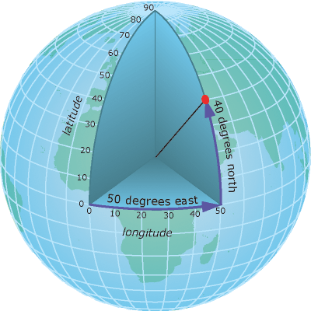
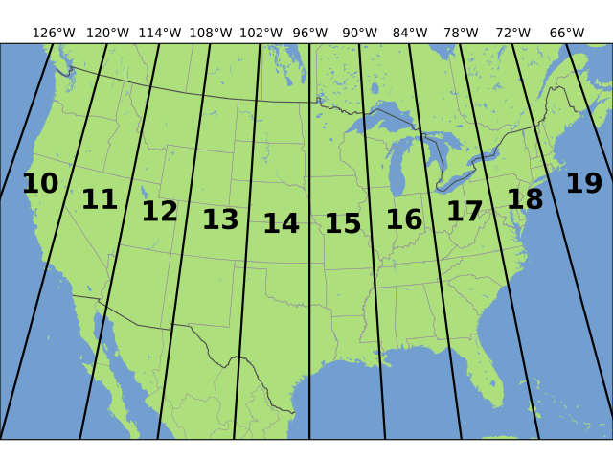
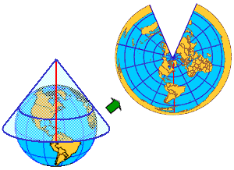
Distortions on 2D Maps
GIS or Geographic Information System is a software created to make digital maps. GIS serves many purposes, it lets us visualize, analyze, interpret data; it helps us understand relationships, patterns, and trends. But there is a problem with using GIS: the world is 3D while a map is only 2D. Fitting a 3D world unto a 2D flat map will cause a map to be distorted. Maps, therefore, will not be a perfect replicate of the real world. This, however, creates a problem in GIS as different data could be using different coordinate systems.
Activate Basemap
Add in Tiger data and Edge data
Transform the feature class into a similar coordinate system
Obtain Shapefile of Manhattan
Clip the feature class to the shapefile
Separate the new feature class.
Edit the Symbology of the recently separated attributes , using unique values.
Switch to layout view to finish the map
Introduction
Methods
Differing coordinate systems and projections can have a dramatic effect on the shape and accuracy of a map, especially when looking at a wide area of a map. Different coordinate systems and projections have their own little niche. The geographic coordinate system is good for referencing a point on a map. The UTM coordinate system is good for looking at state sized area. The Lambert Conic Projection is good for referencing places in the mid-latitudes. With the plethora of different types of coordinate systems and projections, keeping track of different coordinate system when working with data might pose a problem. But the built in tool transform, in ArcGIS, is an easy way to switch all of the data from differing coordinate systems to all of the same coordinate system.
Analysis
Objective/Problem
Create a local data inventory and map of New York.
Change the coordinate systems of the data points.
Figure 01. The finish product of a local data inventory of buildings in New York.
To combat distortions on a map, different projections and coordinate systems are created. Three coordinates system that are commonly used are Geographic, Universal Transverse Mercator (UTM), and NA Lambert Conformal Conic. Geographic Coordinate systems uses longitude and latitude to reference points on a map. The Universal Transverse Mercator divides the world into 60 zones and uses easting and northing as its x and y axes. The NA Lambert conformal conic is a map projection, shown with a cone over or underneath Earth. There are many different coordinate systems and projections and each of these have their pros and cons when being used.
Background Information
Figure 02. Map using the Geographic coordinate system.
Figure 03. Map using the Universal Transverse Mercator coordinate system.
Figure 04. Map using the Lambert Conic map projection.
\
Conclusion
Maps are not accurate representations of the world. That is why different coordinate systems and projections are created to alleviate distortions on a map. For future references this lesson has helped me understand the issues with mapping and experience working on an independent map.
Figure 05. Example of Geographic coordinate system.
Figure 06. Example of Universal transverse Mercator.
Figure 07. Example of NA Lambert Conformal Conic Projection.

