Slide 1
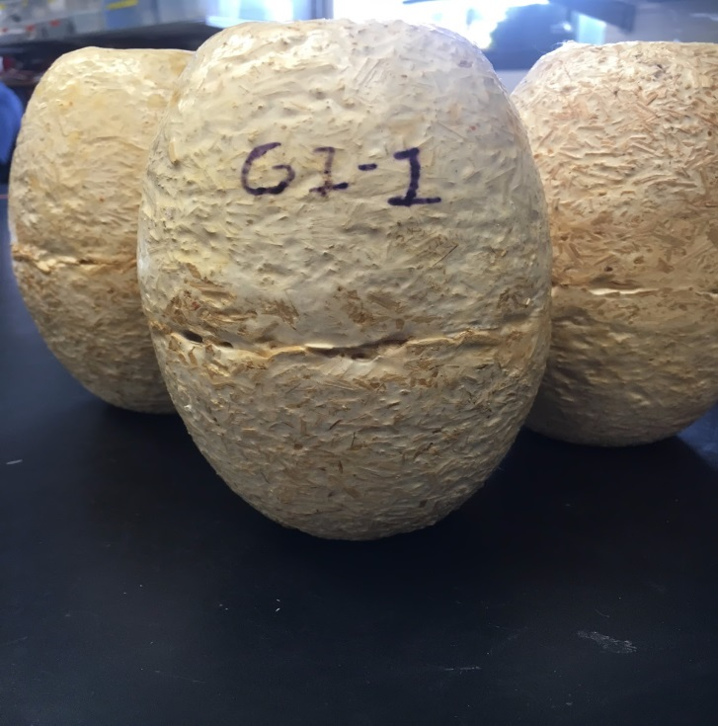
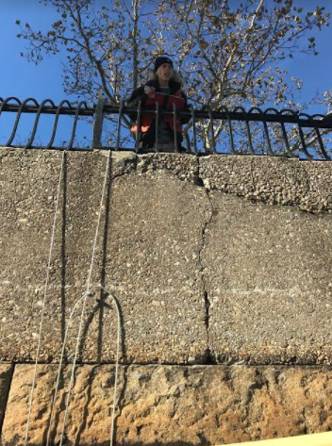
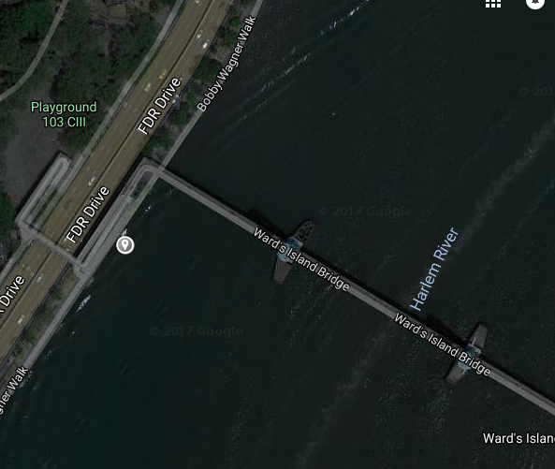
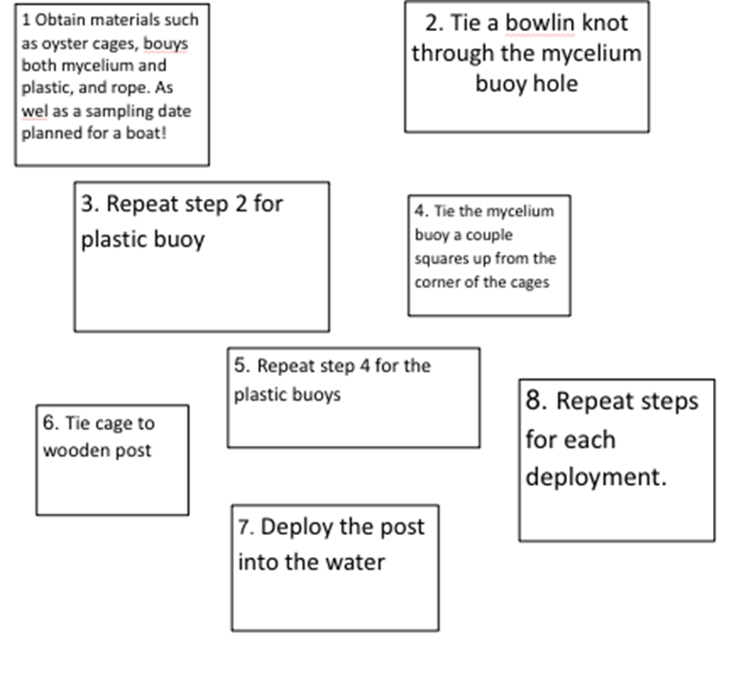
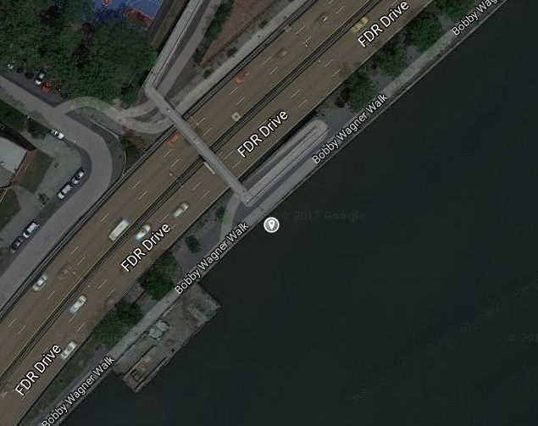
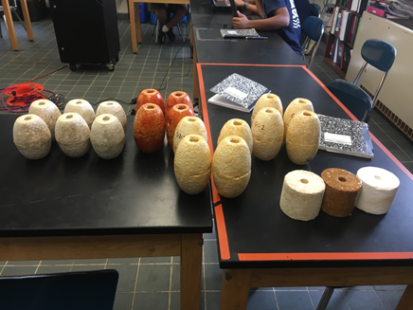
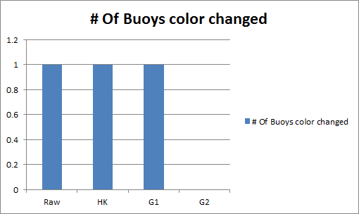
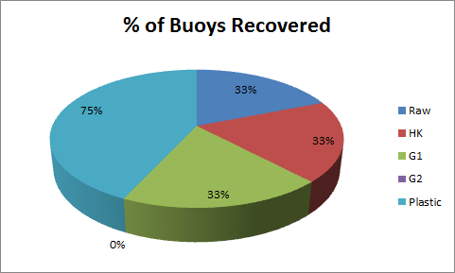
MYCOBUOYS: Testing Different Types of Mycelium Buoys Durability and Longevity
Abstract
Buoy Composition
Sampling Dates
Results (cont.)
Water bodies and environments around the world are currently polluted by plastics and Styrofoam. These plastics and Styrofoam are broken into microfibers that then sit in marine and land environments then harming organisms. One new, currently innovative bio-material is mycelium fungi. Mycelium Fungi have various benefits, one being it’s biodegradability. This allows the composites to be safer for organisms in an environment with mycelium, compared to plastics or Styrofoam. Mycelium Fungi also are good as they recycle nutrients throughout their environment, aquatic or terrestrial. The purpose of making mycelium buoys is to test if a bio-composite fishing net buoy can withstand conditions a normal buoy would, and replace plastics and Styrofoam buoys with an environmentally friendly alternative.
Buoy Type | Mycelium | Mixture | Coating
Raw | PC | Hemp Fines | N/A
HK | PC | Hemp/Corn | Synthetic Epaint
G1 | GR | Hemp/Corn | Synthetic Epaint
G2 | GR | Hemp/Kenaf | 40% biobased epoxy
Localities | Location 1: 103rd | Location 2: 116th
Cages 1-3 | 11-11-16 - 3-25-17 | 12-3-16 - 3-25-17
Cages 4-6 | 11-11-16 - 3-25-17 | 12-3-16 - 3-25-17
Cages 7-9 | 11-11-16 - 3-25-17 | 12-3-16 - 3-25-17
Cages 10-12 | 11-11-16 - 3-25-17 | 12-3-16 - 3-25-17
There wasn’t enough qualitative data showing which buoy sustained the best durability within the given time length. All the buoys that withstood the environmental conditions during deployment were from the Dec 3rd deployment, not the earlier November 11th deployment. The HK (hemp/kenaf) buoy showed the least damage, with little to no chipping and slight discoloration. Raw buoys were very decomposed and almost fallen apart. The G2 buoy also showed more decomposition than the HK sample buoy. The buoy data comes from a sampling date on 3/25/2017. The buoys were re-deployed and the first site was tested on 11/18/17 and 11/25/17. No buoys were recovered at these later dates. The qualitative data show that the Hemp Kenaf buoy is the most reliable alternative.
Figure 01: Different types of mycelium buoys used for deployment and each composition & coating on the buoys
Figure 02: Difference in deployments for the cages. The buoys were deployed at two different locations on two different dates.
Locality
Methods
Discussion
Introduction
Figure 04: Sampling Site 1 – 103rd street along Harlem River under the foot bridge.
Mycelium fungi composites are cutting edge, environmentally beneficial projects. Mycelium buoys were used to test which mycelium composite would sustain durability and longevity through qualitative and quantitative data. The 4 samples were one, uncoated mycelium fines with hemp fines, the 2nd and 3rd sample is G1 and G2 which is mycelium fines with hemp and corn, the difference is G1 contains a water proof epoxy, while G2 is specifically as 40% bio-based Epoxy. The last buoys composite sample was HK which is mycelium fines with hemp/kenaf substrates and the non bio based epoxy.
Mycelium fishing net buoys were deployed and tested for around 11-months to 1 year. The buoy deployments took place on 11/11/16 and 12/3/17. The hypothesis of the experiment was the raw buoys would sustain the least durability due to the buoys having no waterproof coating to slow down biodegradation The first sampling date after around 3-4 months, 03/25/17 show data with various of the given composites still present.
Through qualitative data on the first sampling date, one of each composite was recovered except for a G2 composite. Through the first sampling date (Figure 06), the HK sample showed little chipping, no deforming of the buoy shape, and slight discoloration, while other samples were very beaten, disorganized, or just not present. The buoys were re-deployed for further sampling. Subsequent sampling resulted in no more buoys present. Overall the HK sample shows the most extensive durability and longevity with the given data (Figure 07 and 08). Since the buoys were sampled for an extensive period of time for experimentation, the slight quantitative data was hard to base conclusions on, but could also support as evidence saying the HK buoys withheld parameters as well as or better then the other buoy compositions.
Today people are blind to the impacts that plastics, cardboard, Styrofoam etc. have on the environment. Plastics and Styrofoam don’t degrade for up to 500 years, or more. Styrofoam is also harmful to the environment because mercury adheres to the debris not just as a pollutant (Graca,B., et al., 2013). This is a bad indication of health for animals since mercury is a poison. Testing was done on mercury in Styrofoam debris showing that there was mercury inside the Styrofoam samples. (Graca,B., et al., 2013). Ecovative, a mycelium biocomposite manufacturing company, has new Mycelium Fungi products that can be used as an environmentally beneficial alternative (Lelivelt, R., et al., 2015). “Mycobuoys”, Ecovative’s 100% renewable buoys, would be a suitable alternative because they would biodegrade over time and the mycelium would be able to recycle nutrients in the environment, instead of becoming a pollutant such as Styrofoam (Jiang,L., et al., 2014). Hence by testing and observing the performance of a different “Mycobuoy” composition will be crucial for long term production. With the data it will be easier to determine if the buoys are one step closer and more reliable to use across the world and in real net fishery scenarios or deployment of the buoys on other objects. The “Mycobuoys,” made from Ecovative’s Mushroom® Material, was tested while being suspended with rope into water. (Zeller,P., et al., 2012). The purpose of the experiment was to identify, “Which type of buoy will sustain the best durability and longevity while suspended into water?” This is important because the health of the harbor will continue to decline if the amount of pollutants increase.
The buoys are made in the same shape and measurements like a normal plastic in order to replicate a valid alternative. The plastic buoys will all be held the same and the mycelium buoys will have the same dimensions with some different coatings. Overall if the buoys last long enough and withstand the conditions with the cages like the plastic buoys can, there will be a replacement to plastic debris with an environmentally friendly alternative. Plastics and other harmful materials that are littered commercially everyday will have a substitute. Overall testing mycelium will be an innovative step for preserving water conditions and having less pollution.
Figure 03: Sampling Site 2 – 116th Street along the Harlem River
Results
Before Deployment The buoys before deployment are shown below separated by composition in Figure 05. As you can see, all the buoys are in their molded form and coded dependent on which type of buoy. All the buoys were placed in the water at the same deployment sight, on two deployment days. The 6 white buoys are the raw samples, the buoys second from the left are the Hemp/Kenaf samples and the following are the G1 and G2 samples of hemp and corn with different waterproof coatings.
After Deployment
.
Figure 06: (A) Shows a raw uncoated buoy after deployment, (B) Rope with a mycelium buoy that is no longer present on this cage. (C) Image C is G2 sample next to a red plastic buoy. (D) KF sample after deployments.
Figure 08: Percentage of buoys showing color change
Figure 07: Percentage of each buoy composition recovered from sampling dates including plastic buoys
Bibliography
Arifin, Y., & Yusuf, Y. (2013). Mycelium Fibers as New Resource for Environmental Sustainability. Procedia Engineering, 53, 504-508.
http://www.sciencedirect.com/science/article/pii/S1877705813001847
Graca, B., Bełdowska, M., Wrzesień, P., & Z Grundo, A. (2013). Styrofoam debris as a potential carrier of mercury within ecosystems. Environmental Science and Pollution Research, 21(3), 2263-2271. doi:10.1007/s11356-013-2153-4
Haneef, Muhammad, et al. “Advanced Materials From Fungal Mycelium: Fabrication and Tuning of Physical Properties.” Nature News, Nature Publishing Group, 24 Jan. 2017, www.nature.com/articles/srep41292..
Jiang, L., & Walczyk, D. (2014). Vacuum Infusion of Mycelium-bound Biocomposite Preforms with Natural Resins. Full-text Conference Paper. Retrieved from https://www.researchgate.net/publication/274139042_Vaccum_Infusion_of_Mycelium-bound_Biocomposite_Preforms_with_Natural_Resins
Jiang, L., Walczyk, D., Mcintyre, G., & Bucinell, R. (2016). A New Approach to Manufacturing Biocomposite Sandwich Structures: Mycelium-Based Cores. Full-text Conference Paper, 1-12. Retrieved from https://www.researchgate.net/publication/305279358_A_New_Approach_to_Manufacturing_Biocomposite_Sandwich_Structures_Mycelium-Based_Cores.
Jiang, L., Walczyk, D., & Mcintyre, G. (2017). A New Approach to Manufacturing Biocomposite Sandwich Structures: Investigation of Preform Shell Behavior. Journal of Manufacturing Science and Engineering.
Lelivelt, R., Lindner, G., Teuffel, P., & Lamers, H. (2015,). The production process and compressive strength of Mycelium-based materials. First International Conference on Bio-based Building Materials., 22-25. Retrieved from https://pure.tue.nl/ws/files/15138585/leliproduct2015.pdf.
Wallander, H., Nilsson, L. O., Hagerberg, D., & Baath, E. (n.d.). Estimation of the biomass and seasonal growth of external mycelium of ectomycorrhizal fungi in the field. Retrieved January 31, 2017, from http://onlinelibrary.wiley.com/doi/10.1046/j.0028-646x.2001.00199.x/full
Zeller, P., & Zocher, D. (2012). Ecovative’s Breakthrough Biomaterials. Ecovative’s Breakthrough Biomaterials, 5(1). Retrieved from http://www.fungimag.com/spring-2012-articles/LR_Ecovative.pdf
Picture 03: Shows the sample set for the different types of buoys being tested. All of the composed buoys were used during sampling.

