Slide 1
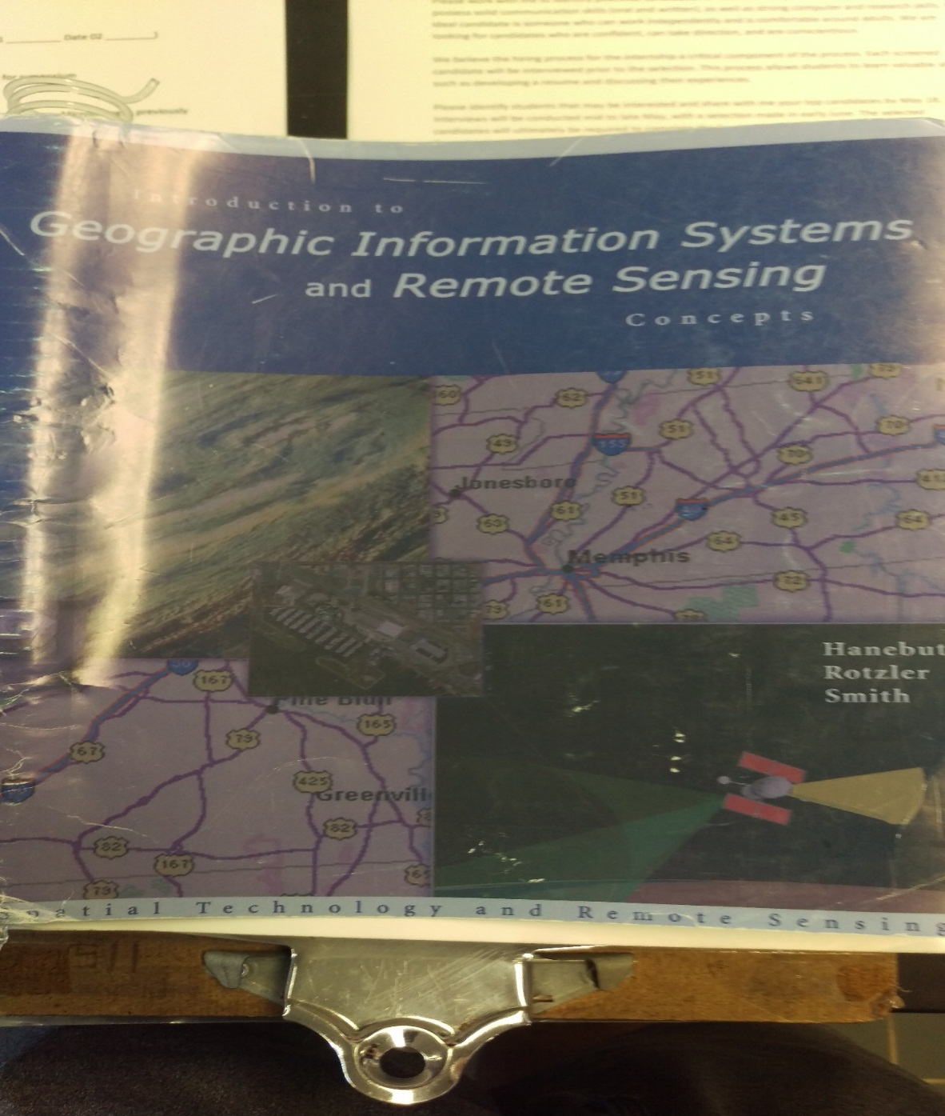
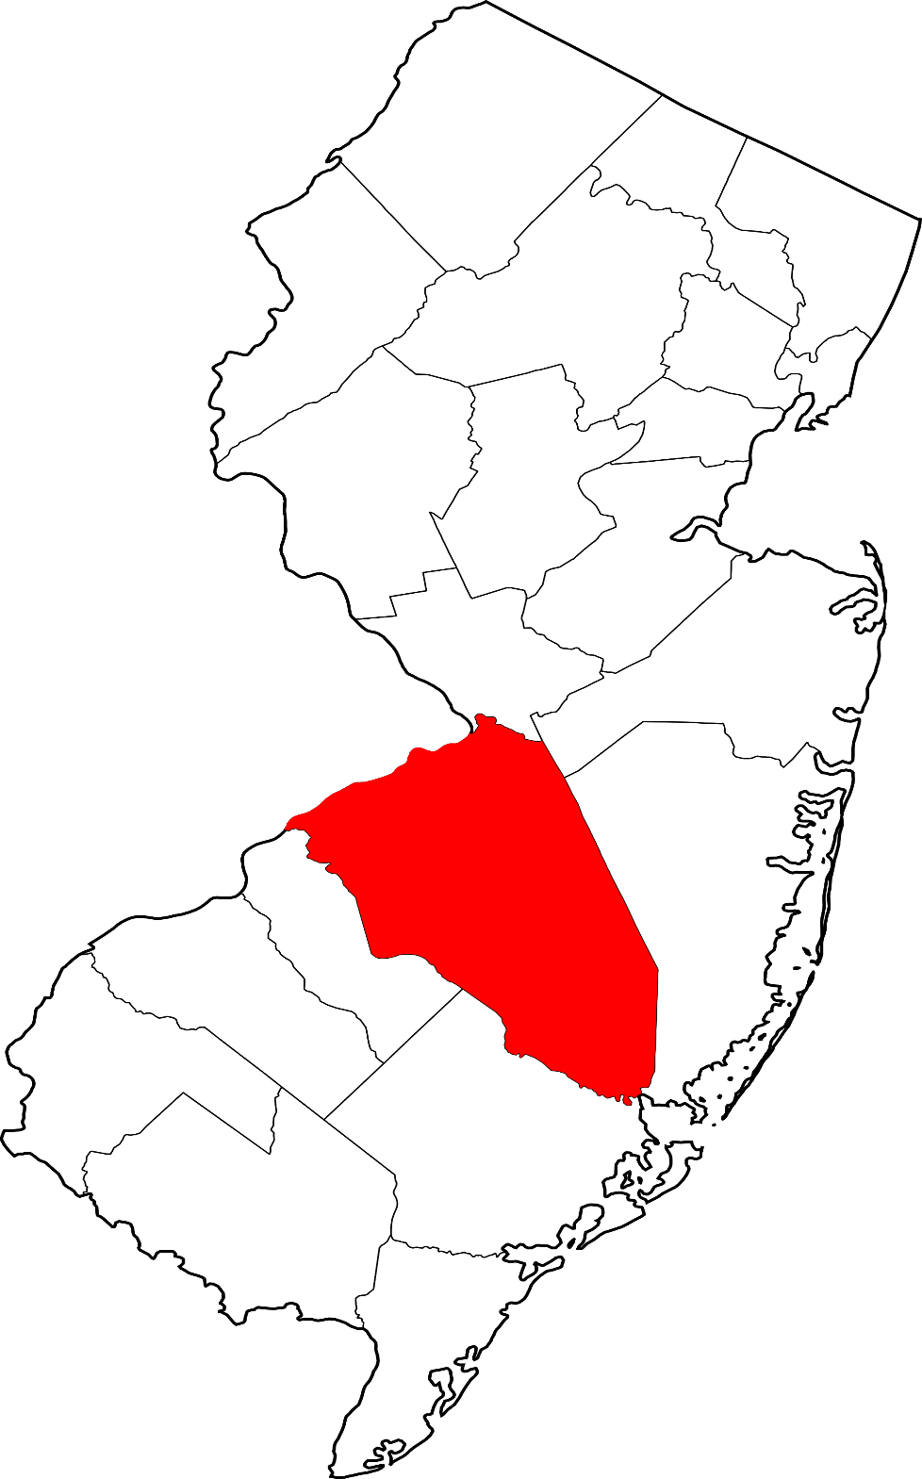
Combining Geospatial Technology with Surveys
Abstract
Results
ArcGIS (Geographic Information Systems) is a program used by many people to create maps. I’ve learned how to make maps using data gathered by third party sources. The work also requires a group review of the lessons covered. Currently the lessons I’m working to complete are teaching me how to use ArcCatalog. ArcCatalog is used to organize different geographic information for ArcGIS. This curriculum will eventually show how to create original maps without having to use data given from the textbooks. Overall there has been a lot to learn from the program and it has given me tools to create maps using other forms of data such as vector or raster. While I am not looking to pursue this field after this year the skills I have gathered from the lessons could benefit me in the future. It can be used to create maps for areas of high crime reports. This lesson combines a survey of reports of crime in residential areas by call.
The map created shows the areas where there is a surplus of crime reports. The results show this county has reports scattered along the county and is typically around the center of the county. This map shows that combining a survey and geospatial technology is extremely beneficial. The data in the map now shows areas of burglaries with the black dots on the map. It also displays the parcels containing most of the crime reports in an area marked by many red lines. The map shows all the data in the survey and where they are. This allows us to see how closely the crimes are connected. This can be used to find out if there is a pattern to these crimes or if they are just random occurrences. Seeing that most crimes are within a mile of each other can lead to a theory of why all these reports are called in. The map displays the finished product of this lesson which is a proven way to share georeferenced data that everyone can understand. The results from this lesson have furthered my understanding of the program and what it can be used for.
Introduction
Conclusion
GIS can be used to not only make maps for direction, but can also be used to map areas of crime reports as shown in the map at the center. This map was created based off of data from a report which displayed calls of crimes and burglaries. The Brown and Smith survey companies provided the land parcel surveys to us for this study. Taking data from the study and combining it with the base map is one of the first steps when implementing a project. The map is of Burlington county which is the second largest county in New Jersey.
These data, when turned into a map, show more trends in crime because it visually displays the areas of crime. The survey only shows the names and the number of crimes making it hard to see patterns in the data. You would have to memorize the areas relative to each other to realize a trend but that makes it only available to a select few people to interpret. Combining data and maps not only makes it easier for you to understand but it makes it clear for stakeholders or any one else involved with the project.
Methods
Objectives/ Problem
Skills learned / steps
Create a map to display crime in residential areas
Create a report showing the calls for service of crimes
Combine a survey with GIS
Find trends in the data based of the data
1) Navigate to S1U1L5 mxd file
2) Merging Buffers to create a whole new buffer by combining the effects of both
3) Remove layers from the map options
Save
4) Edit layer properties
5) Changing the Symbology of a layer to alter the color
6) Select Medford parcels layer by location
Export map
7) Apply search distance, changing it to 300 feet
8) Export data from Medford parcels
9) Create a report for residential areas near burglaries
Figure 01. The GIS curriculum is provided by a company called Digital Quest.
Figure 2: Picture of Burlington county which is where the map is located

